Slide 1
The Application of Sentiment Models to Hate Speech Detection
Marina Sanchez and Mileva Van Tuyl

Slide 2
Contents
Motivation
Objectives
Approach
Sentiment Classification Models (Naive Bayes, LSTM, Vader)
Results and Analysis
Conclusions

Slide 3
Introduction

Slide 4
Motivation
“Hate speech and sentiment analysis are closely related, and it is safe to assume that usually negative sentiment pertains to a hate speech message” (Schmidt et al., 2017)
Notes:
The detection of Hate speech is a very important issue to address
The uncontrolled spread of hate has the potential to gravely damage our society: individuals and groups.
Nowadays social media is a huge source of hate spread
Lot of work on Sentiment analysis -> check if its a good way of detecting hate speech

Slide 5
Objectives
Compare the performance of three different sentiment analysis models (Naïve Bayes, LSTM, and Vader).
Determine whether modern sentiment analysis techniques are an effective approach for detecting hate speech.
Evaluate whether hate speech is predominantly of negative sentiment.

Slide 6
Approach

Slide 7
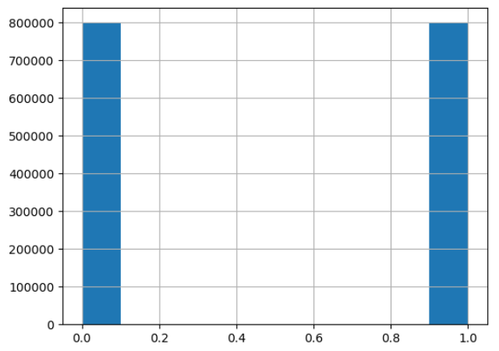
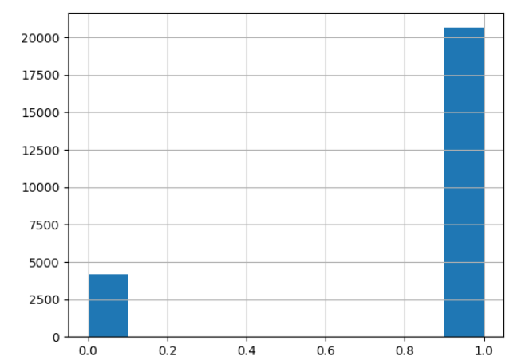
Datasets
Sentiment140 dataset 1.6 million tweets
Target: the polarity of the tweet
negative
positive
Text: the text of the tweet
Hate speech dataset 24,783 tweets
Tweet: text of the tweet
Class: classification of the tweet
Hate Speech
Offensive Language
Neither
positive
negative
neutral
Hate speech and offensive language
Notes:
Texts considered racist, sexist, homophobic, or generally offensive.
Sentiment140 dataset: 1,600,000 tweets
Hate speech 24783

Slide 8



Methodology
Data cleaning: case-folding, extra spaces, punctuation, tokenization, and lemmatization
Build Sentiment Classification Models: Naive Bayes and LSTM
Train models on sentiment data
Hyperparameter tuning
Evaluation: accuracy, F1, recall
Apply Sentiment Classification Models on Hate Speech data
Naive Bayes, LSTM and VADER (pretrained) on hate speech dataset
Evaluate and compare performances
Notes:
MR

Slide 9
Sentiment Classification Models

Slide 10

Naive Bayes
The Naive Bayes classifier is a classification algorithm based on Bayes’ Theorem
Bayes’ Theorem finds the probability of an event A occurring given the probability of another event B that has already occurred
Model Training
Further preprocessing and transformations:
Stop words
TF-IDF Vectorization: Converts collection of documents to a matrix of TF-IDF features
Hyperparameter tuning
Notes:
it uses conditional probabilities of each lexical feature occurring in either positive or negative text in the training data to arrive at the outcome.
The program guesses the tag of a tweet (pos/neg), using the Bayes theorem. It calculates each tag's likelihood for a given sample and outputs the tag with the greatest chance

Slide 11
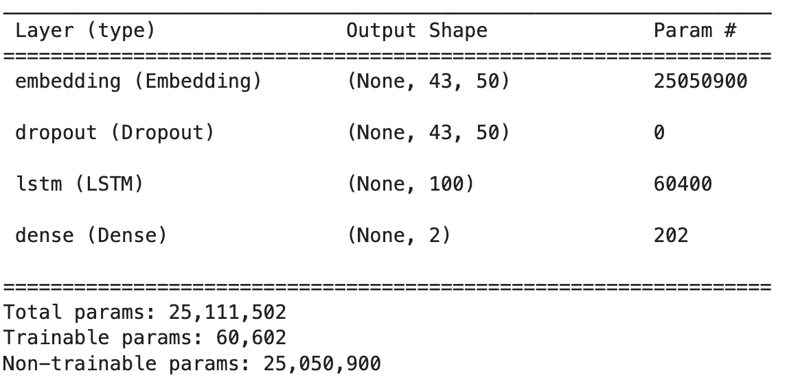
LSTM Recurrent Neural Network
Cleaning and preprocessing (e.g. texts to sequences)
GLoVE embeddings: glove.twitter.27B
Optimizer: adam, loss: categorical_crossentropy, epochs: 5
Notes:
LSTM - Long Short-Term Memory
Advantage: treats tweets as a sequence of words, thus considering word order and word context
Cleaning - same as Naive Bayes (case-folding, tokenization, lemmatization, etc.)
Preprocessing - left stop words, didn’t use tf-idf. Rather used texts to sequences
Iteration 1 => Overfitting & time consuming to learn 25million parameters
Embedding layer: learn word embeddings/ dense vectors (rather than sparse vectors) → 50-dimensional
Bidirectional LSTM layer
Dense layer
Getting good results. 80-81% accuracy on the test set but overfitting and taking a long time
Solution: Use GLoVE embeddings
Iteration 2 => No longer overfitting, fewer parameters to learn. Required more epochs
GLoVE embeddings for the embedding layer: glove.twitter.27B - 27B tokens based on 2B tweets.
Dropout layer
LSTM (rather than bidirectional)
Dense layer

Slide 12
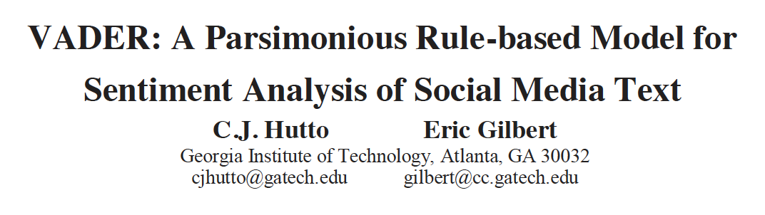
VADER
Valence Aware Dictionary for Sentiment Reasoning
Identifies polarity and intensity (+4 to -4) of sentiment
Notes:
Out-of-the-box model that requires no training data - based on a lexicons & linguistic rules
Identifies polarity and intensity of sentient
Intended to work well on social media style text
Generalizes more favorably across contexts

Slide 13
Evaluation on Sentiment140 Dataset
How well does the sentiment model perform on the test set?
 | Naive Bayes | LSTM | Vader
F1 | 0.581 | 0.789 | 0.661
Accuracy | 0.578 | 0.788 | 0.653
Recall | 0.586 | 0.792 | 0.679
Notes:
LSTM performs best on the test set for the sentiment data. But most computationally expensive to train and optimize
Then VADER
Then Naive Bayes - slightly better than random guess

Slide 14
Performance on Hate Speech Data
Notes:
Remember our 2 goals:
Determine whether modern sentiment analysis techniques are an effective approach for detecting hate speech.
Evaluate whether hate speech is predominantly of negative sentiment.
Applied sentiment model to hate speech data (no retraining)

Slide 15
Results
 |  | Naïve Bayes |  |  | LSTM |  |  | VADER
Hate Speech | No | 0.53 | 0.47 | No | 0.71 | 0.29 | No | 0.4 | 0.6
 | Yes | 0.43 | 0.57 | Yes | 0.56 | 0.44 | Yes | 0.19 | 0.81
 |  | Positive | Negative |  | Positive | Negative |  | Positive | Negative
 |  | Sentiment
Notes:
Remember the imbalance in our dataset for hate speech data
In the confusion matrices, we’ve normalized across the rows.
Looking at the matrices, we observe some mixed results.
Naive Bayes: Slight favoring of the TP and TN as we want
LSTM: Performs well on non-hate speech data
VADER: Performs well on hate-speech data

Slide 16
Analysis
Are sentiment classification models an effective approach for detecting hate speech? Is hate speech predominantly negative sentiment?
 | Naive Bayes | LSTM | Vader
F1 | 0.687 | 0.583 | 0.838
Accuracy | 0.565 | 0.482 | 0.740
Recall | 0.572 | 0.435 | 0.810
Notes:
1. Are sentiment classification models an effective approach for detecting hate speech?
The results are relatively inconclusive.
Looking at F1 and accuracy
Our Naive Bayes and LSTM sentiment models don’t transfer well to hate-speech detection
However, VADER does transfer well
⇒ VADER performs best, then Naive Bayes, then LSTM
This makes sense as VADER is thought to generalize more favorable across contexts (and maybe tasks)
2. Is hate speech of predominantly negative sentiment?
Look at Recall. Recall says what percentage of tweets that are hate speech are thought to be of negative sentiment?
Generally Recall is over 50%, indicating hate speech is predominantly negative sentiment

Slide 17



Conclusion
Evaluation of 3 models: (1) LSTM, (2) VADER, (3) Naive Bayes
Inconclusive if sentiment models can be used for hate-speech
detection tasks
Hate speech leans in the direction of negative sentiment
Notes:
Potential next steps:
To address inconclusive results: use more training data for our pre-built models, look at other pretrained sentiment models like TextBlob
Hate-speech models, consider research that uses hybrid approaches (e.g. sentiment + topic modeling)

Slide 18
References
Schmidt, Anna, and Michael Wiegand. "A survey on hate speech detection using natural language processing." Proceedings of the fifth international workshop on natural language processing for social media. 2017.
Hutto, C.J. & Gilbert, E.E. (2014). VADER: A Parsimonious Rule-based Model for Sentiment Analysis of Social Media Text. Eighth International Conference on Weblogs and Social Media (ICWSM-14). Ann Arbor, MI, June 2014.
Liu, Shuhua, and Thomas Forss. "New classification models for detecting Hate and Violence web content." 2015 7th international joint conference on knowledge discovery, knowledge engineering and knowledge management (IC3K). Vol. 1. IEEE, 2015.
Sentiment Analysis — Comparing 3 Common Approaches: Naive Bayes, LSTM, and VADER
https://www.kaggle.com/datasets/kazanova/sentiment140
https://www.kaggle.com/datasets/mrmorj/hate-speech-and-offensive-language-dataset
GloVe: Global Vectors for Word Representation

